Slide 1

by
Fall Protection Training
By Jennifer Keefer

Slide 2
Introduction
https://www.youtube.com/watch?v=kF9jXZDYCxE

Slide 3
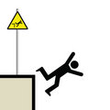
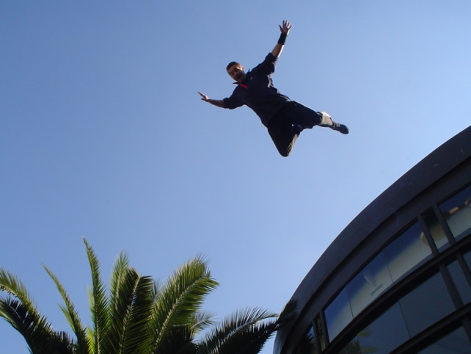
Objectives
Regulations
Basic Steps
Requirements & Safety Precautions
Diagram of the roofs
Questions

Slide 4

Regulations
29 CFR 1910
DON Fall Protection Guide
OPNAVINST 5199.23G
NSAMINST 5100.5
NPSINST 5100.1

Slide 5

Fall Protection
Step 1: Want to go on roof (applies to roofs with no guards ie, Root, Halligan and Bullard
Step 2: Notify Fall Protection Manager (Jennifer) and/or Competent Person (Michele)
Step 3: Review Fall Protection & Prevention Plan or Fall Prevention Risk Management Sheet
Step 4: Implement Risk Assessment into work
Step 5: Alert NPS Safety in case of any issues
Step 6: Let NPS Safety know work is complete

Slide 6

Fall Protection
Ensure the NPS Safety office is aware of your presence/work on the roof and the expected time frame to perform the work and duration
Do not work on roof alone –always work in pairs. One individual shall be designated as a safety monitor/recorder and assistant by maintaining visual and verbal contact at all times during the work
Ensure you have a form of communication link with Activity Safety Office (Cell phone, etc.)

Slide 7

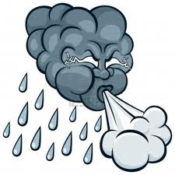
Fall Protection
Ensure proper footwear
Depending on weather conditions suggest wearing the following:
      Sunglasses
      Sunscreen
Check weather for windy and rainy conditions which will be more dangerous
Report injuries immediately to the NPS Safety Office

Slide 8
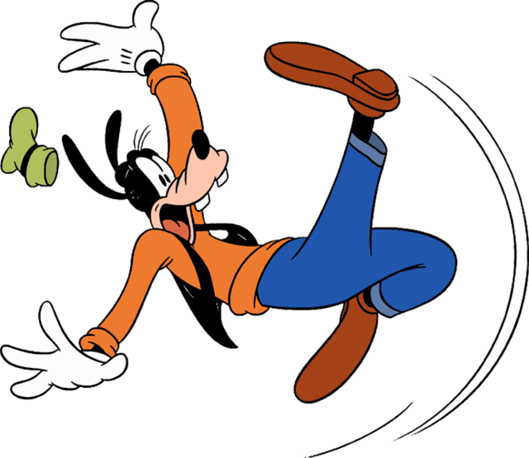
Fall Protection
Ensure there is a safe method for accessing and exiting the roof
Roof areas should be tidy and clean
If rubbish or stacked material interferes with accessing and performing inspection of the roof, do not proceed until it is safe to perform the work
Ensure the roof surface is not slippery due to water, algae, dirt, and debris that would preclude firm footing

Slide 9
Fall Protection
Ensure all ladders are safe and any scaffolding used for access is certified and safe
Ensure there is a safe method of transporting equipment or tools to the roof area if needed
Personnel performing work shall not proceed to within 6 feet of the unprotected edge
The 6 feet area adjacent to the unprotected roof edge is called the control zone
Inspection and investigation work can be performed in the safe zone without the use of a fall protection method

Slide 10
Fall Protection

Slide 11
Fall Protection

Slide 12
Fall Protection

Slide 13
Fall Protection

Slide 14
Fall Protection

Slide 15

Questions

