Slide 1


JOINT INTERAGENCY
FIELD EXPERIMENTATION
(JIFX)
NAVAL POSTGRADUATE SCHOOL

Slide 2


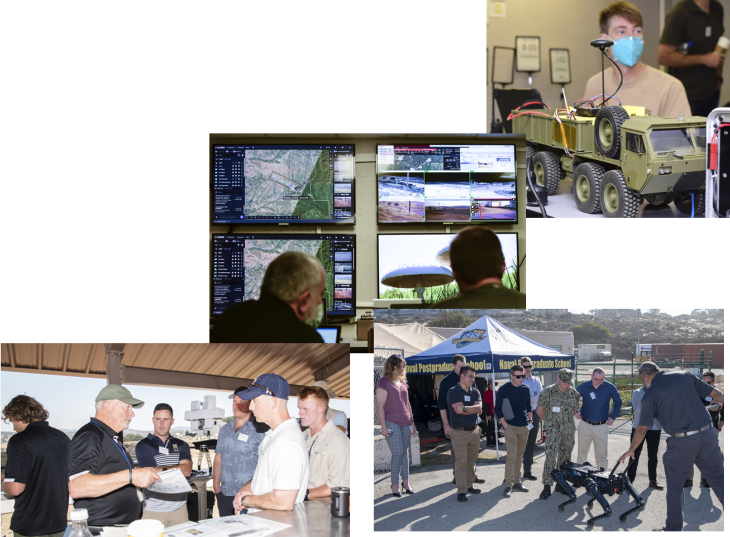
Agenda
JIFX Overview
Events
Success Stories
Participation

Slide 3
What is JIFX?
An experiment in alternative methods to enable rapid technological development.
Community of Innovators in dialogue with DoD, USG, and Allied technology developers to identify, influence, and accelerate early-stage technology that address national and collective security challenges.
Provides government, academic, and industry researchers a turn-key solution for safe, secure, legal, and collaborative experimentation on a quarterly basis.
We provide a realistic field environment
Experimenters provide an emerging technology
Together we collaborate and learn!
Notes:
A community of NPS faculty & students, Joint & Allied warfighters, and Technology Developers within the DoD, USG, Academia, & Commercial Industry
Serves as a bridge between members of the community informing warfighters about state-of-the-art technology and technology developers about warfighter needs & requirements
A year-round program anchored by quarterly week-long field events
The purpose of JIFX is to:
Accelerate innovation and explore technologies that have the potential to address National Defense Strategy objectives
Represents a low overhead venue for technology developers to conduct field experimentation
Provides vulnerability assessments and end-user evaluations technology developers early in the development cycle
Validate capabilities that fit in DOD’s seams and gaps
Rapidly assess a wide range of technologies from small businesses, academia, and the defense industry
Provide an accessible and collaborative learning environment featuring easy access for industry, academia, partner nations and other organizations
Helps to avoid technological surprise
Early Engagement:Allows CCMD S&T advisors to engage with developers in a non-acquisition environment

Slide 4

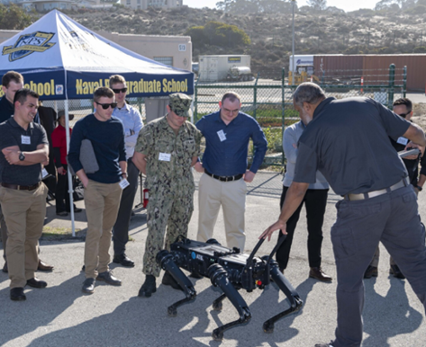
Culture: Principles
Austere by Design
Bounded, Not Controlled
Inclusive
‘Develop Now’ mantra
Collaboration is Expected
Failure is Acceptable

Slide 5
Culture: A Continuous Cycle
Annual RFI is created based on Stakeholders identified interest areas
Experimenters submit Experiment Proposals
Proposals are reviewed by NPS & Stakeholders
Stakeholders vote on relevance of each proposal
NPS invites and coordinates participation of accepted experimenters
JIFX Event

Slide 6
Culture: Experiment Focus Areas
Unmanned Aerial System
Unmanned Systems Design, Deployment, Operation, Networking & Control
Countering Unmanned Systems
Communication and Networking
Cyber, Cyber Security, and Electronic Warfare
Intelligence, Surveillance and Reconnaissance
Situational Awareness
Defense Support to Civil Authorities
Health and Safety
Expeditionary Operations
Infrastructure and Power
Mobility and Transportation
Precision strike, Non-Lethal Weapons, Information Operations

Slide 7
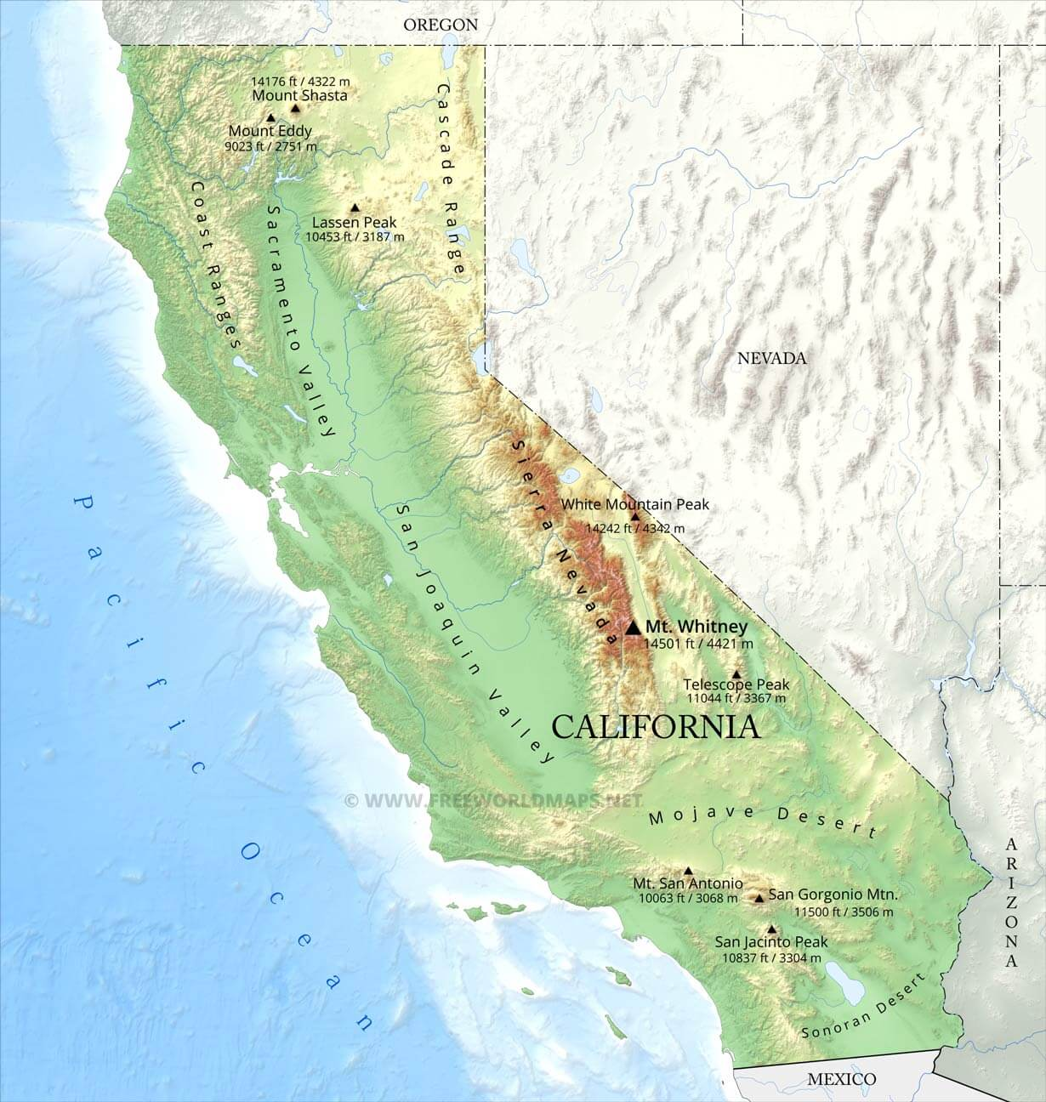
Capabilities
Event Locations
NPS Sea, Land, Air Military Research (SLAMR) Facility
NPS Field Laboratory at Camp Roberts Army National Guard Base (Primary)
Virtual Participation
Notes:
Where JIFX works #1

Slide 8

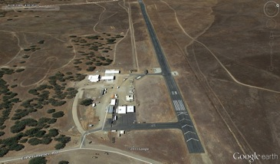
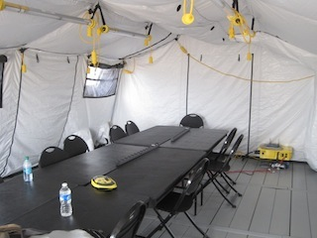
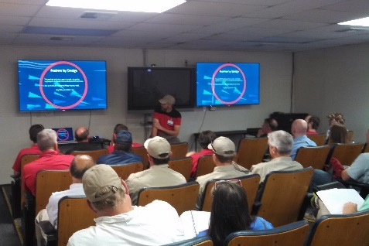
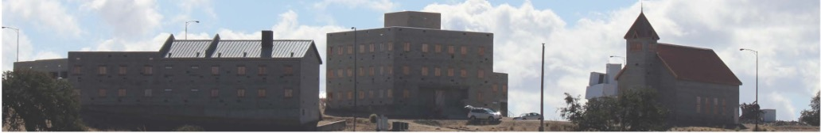
Capabilities: Camp Roberts
Controlled air & electromagnetic domains
  Paved assault landing strip
  Restricted Airspace to 15,000ft MSL
  Restrictive Terrain
Maneuver area – 30,000 acres
Combined Arms Collective Training Facility
Live-fire training facilities
Networked “Technical Operations Center”
Notes:
Where JIFX works #1
Capabilities we leverage that Experimenters Use
+ Twin Bridges (Box Canyon)
+ Tunnel system
+ FOB
+

Slide 9
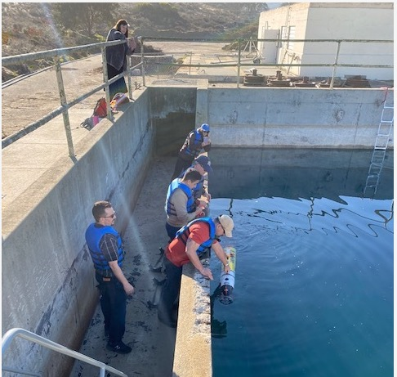
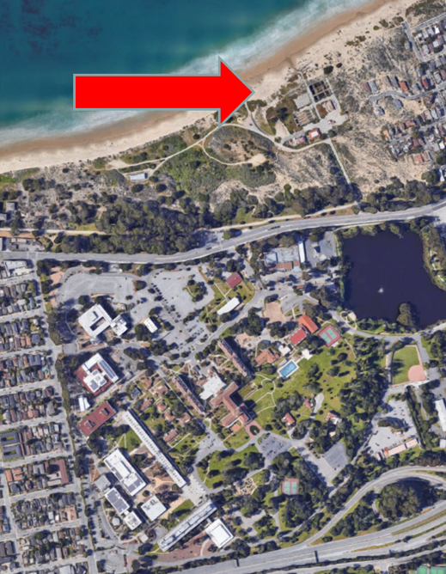
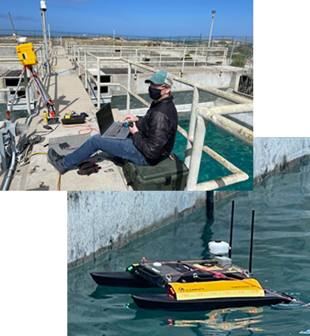
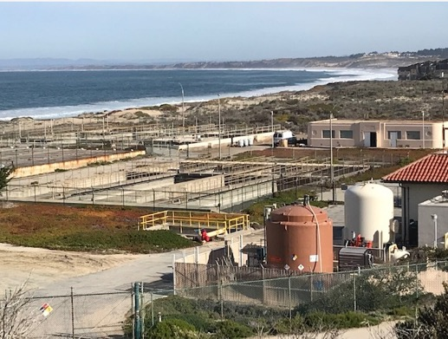
Capabilities: NPS
Sea Land Air Military Research (SLAMR) Laboratory
  Co-located with main campus
  Repurposed Waste-Water Treatment plant
    3x In-ground Treatment Tanks
    Hardscape and dunes
  5G Array
  Network infrastructure provides real-time connectivity to JIFX at Camp Roberts & other locations
  Future Subterranean & Air domain capabilities along with activities in bay
NPS Campus
Notes:
Where JIFX #2
3x In-ground Treatment Tanks - 33’ wide x 111’ long x 14’ deep, approx 415,000 gallon
JIFX is all about the team, the participants, and the needs – we can facilitate Field Experimentation anywhere; Monterey Bay; Alameda//SF Bay; San Clemente

Slide 10
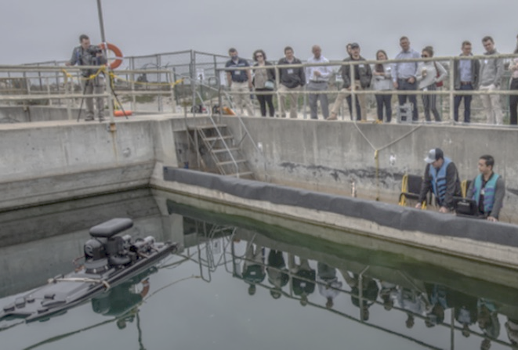
Community
Stakeholders
  US Combatant Commands (Primary)
  All other DoD Organizations
  Interagency (other federal organizations)
  Allied Forces
  State & Local Government Organizations
Innovators
  Commercial Industry
  Military Commands
  Federal Government Research Organizations
  Academia
  Non-Profit / Non-Governmental Organizations
  NPS Faculty and Students
Evaluators
  Uniformed Military with varied technical backgrounds
  NPS Faculty and Students
  Red Team: Joint Vulnerability Assessment Branch (JVAB)
Notes:
Community Visiting Camp Roberts
Stakeholders include: AFRL •AFSOC •Defense Threat Reduction Agency (DTRA) •DHS Customs and Border Protection •DIU •DoE •National Maritime Intelligence-Integration Office •NAVFAC EXWC •NIWC Pacific •NOAA NSW •NSWC Coronado •ONR •CPD (formerly RRTO) •US Army DEVCOM •US Army Futures Command •USCENTCOM •NORTHCOM •INDOPACOM (next event) •USSOCOM •USSTRATCOM •USTRANSCOM
MCWL welcomed as stakeholders and experimenters! Also, can nominate experiments as well as other stakeholders.

Slide 11
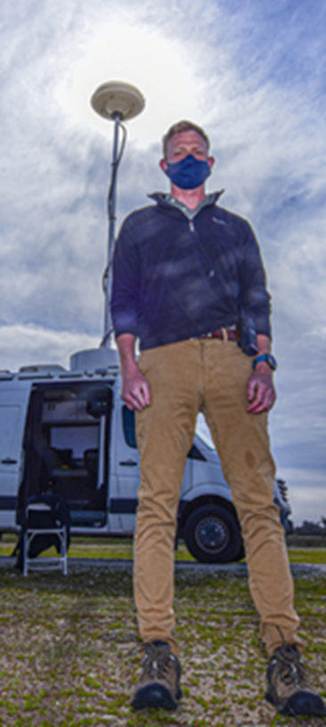
Supporting the NPS Mission
The Naval Postgraduate School provides defense-focused graduate education, including classified studies and interdisciplinary research, to advance the operational effectiveness, technological leadership and warfighting advantage of the Naval service.
JIFX supports the NPS mission by providing:
  controlled sites to conduct interdisciplinary graduate education and research for students
  applied research opportunities to evaluate the latest technologies and remain on the cutting edge of their disciplines
  a platform for DoN, sister services, and DoD agencies to field test prototype platforms, payloads, and concepts of operations
Notes:
Why JIFX exists

Slide 12

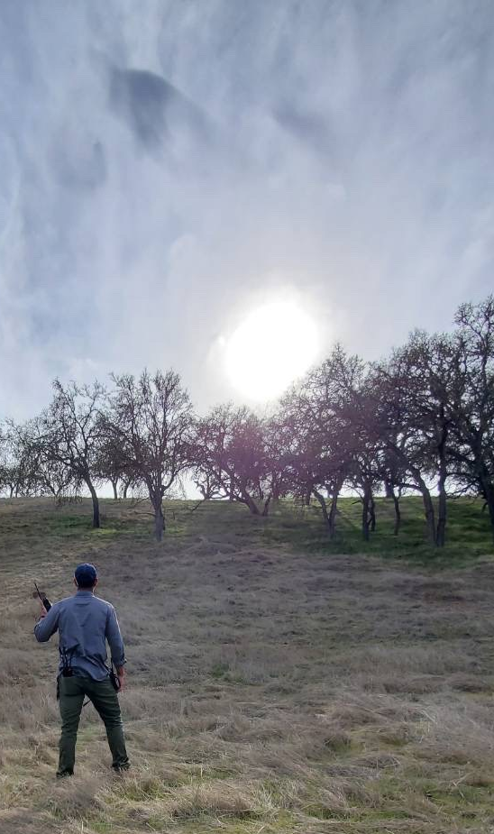
Doubling Return on Investment
USMC Students at JIFX 21-2 (1-5 MAR 2021)
Experiment: : Tactical RF Signature Manipulation techniques to obfuscate a communications system’s electromagnetic signature that challenges state-of-the-art direction-finding systems.
Highlight: Unmanned platform enabled techniques and experiment parameters for evaluation at altitude - effectively enhancing power received at the sensor.
Interim Conclusion: Techniques used against the DF system proved effective beyond anticipated estimates.
Support: Air Ops, Spectrum Mgr, and Joint Vulnerability Assessment Branch (JVAB) of US Army’s Unique Mission Unit
Follow-on: Evaluate techniques against the DF system at maximum theoretical estimates.
Returning More Capable Leaders to the Force: Thought Leaders and Subject Matter Experts who are Technologically literate and Competent moving from theory to application
Notes:
Luke Klena and Joe Skopowsky

Slide 13
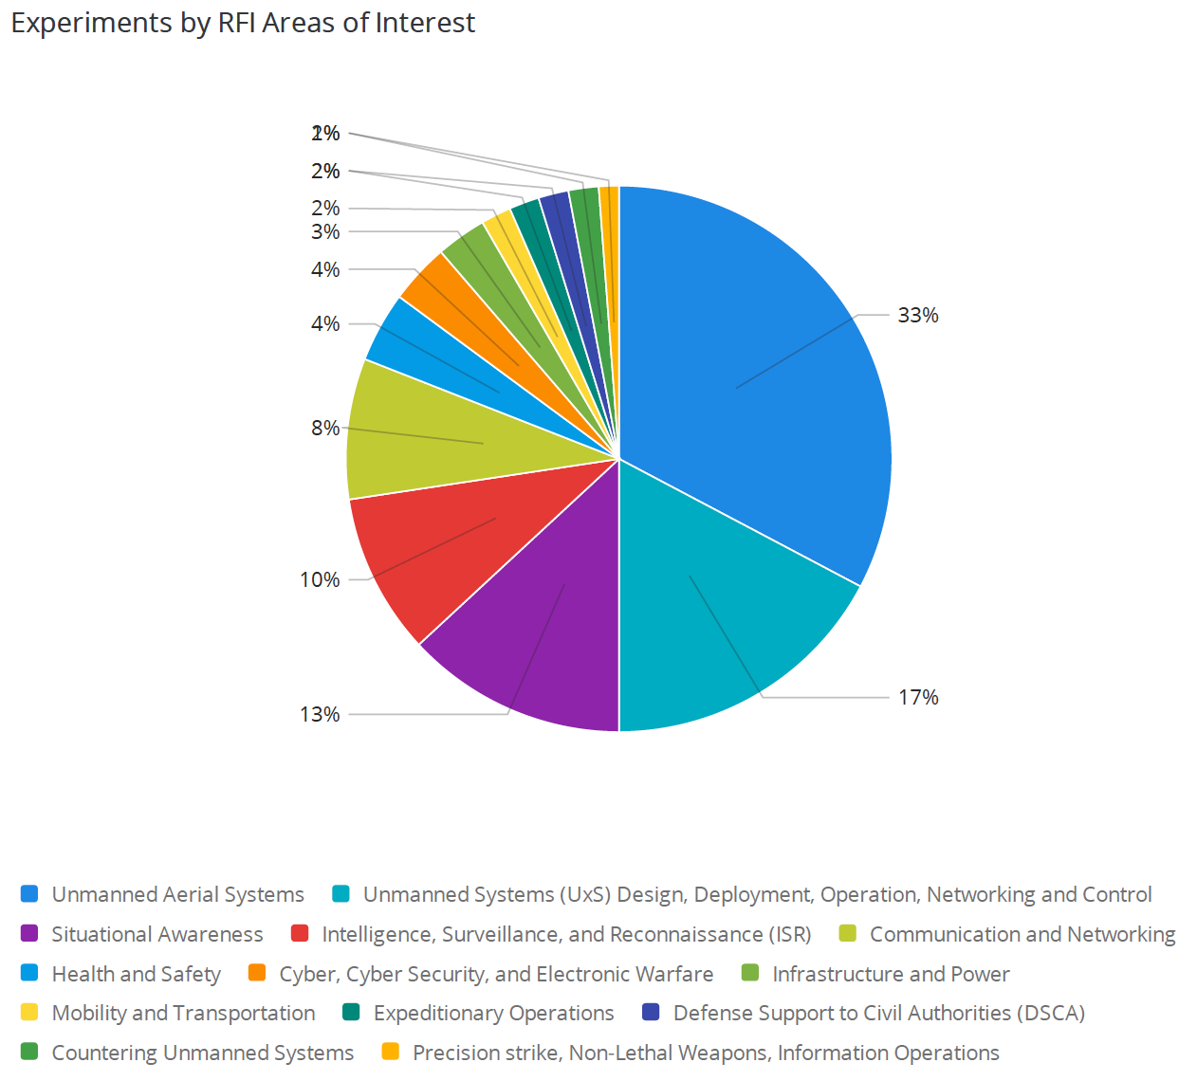
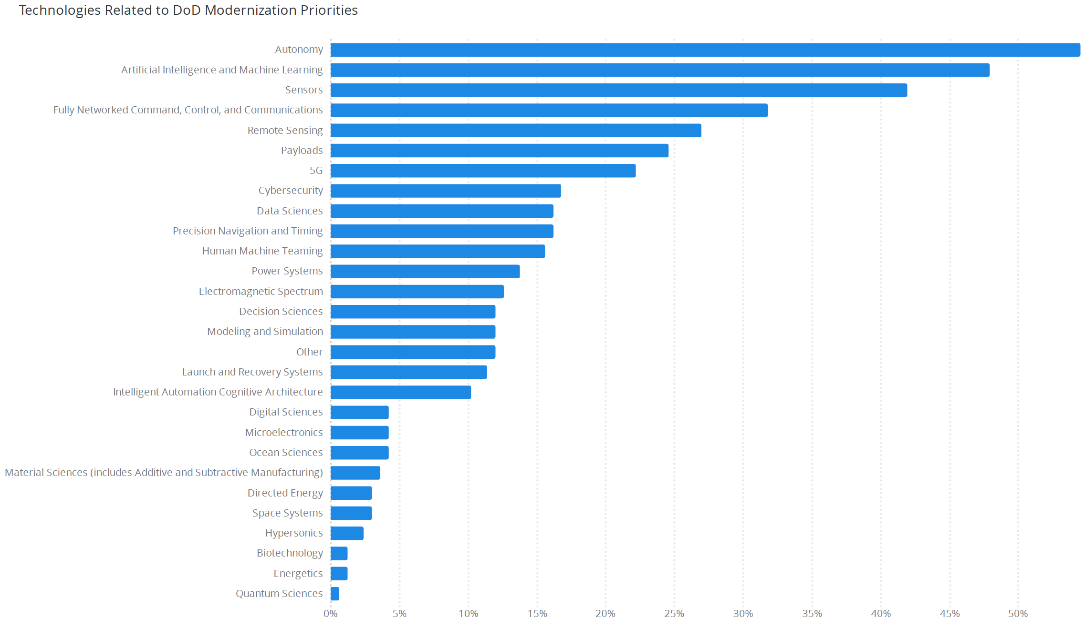
2020–2022 Event Statistics
1789
Participants
205
Experiments
46
Cyber Vulnerability Assessments
536
Sorties
Notes:
Eleven events total: one cancelled at beginning of Pandemic; one virtual; then hybid with select in-person, distributed, and virtual; return to full in-person while retaining virtual and distributed capabilities

Slide 14
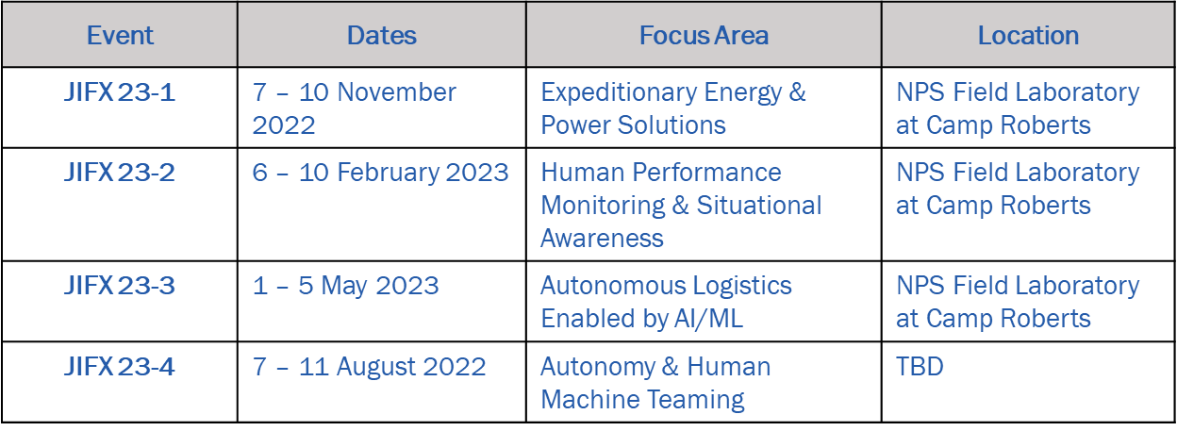
FY2023 Events
Notes:
Date: 7 – 10 November 2022
Concentration Areas:
Renewable energy
Scalable energy harvesting and scavenging technologies
Next-generation photovoltaics
Alternative fuel for portable, light-weight applications
Logistics decision support tools relevant to energy
Beyond traditional batteries for military applications
Deployable, self-sufficient infrastructure
Research Challenges:
Address the security implications of climate change including the role of autonomous systems and the impacts of energy
Improve and extend the endurance of unmanned vehicles
Investigate nanogrids for improved military installation energy resilience
Design and utilize energy scavenging technologies to passively power equipment and charge batteries for individuals and small units in varying environments
Demonstrate environmentally stable, flexible, high-specific power solar cells
Develop software and energy planning tools to plan for and reduce energy consumption across elements relevant to military operations

Slide 15

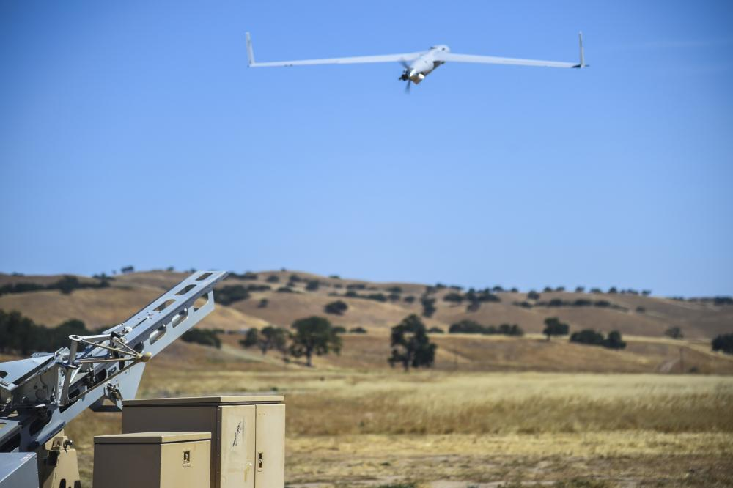
Success Stories: ScanEagle
2006: Flew first modified payload capable USN ScanEagle at JIFX event
2008: In conjunction with NSW, conducted first launch from Mark V Special Operations Craft
2009: ScanEagle flew from USS Brainbridge ISO operation to rescue crew of MV Maersk Alabama from Somali Pirates
2010: Tested rapid-deployment SIGINT payload (SIGEAGLE) prior to deployment to USMC in Afghanistan
2013: Experimentation with autonomous copilot software

Slide 16
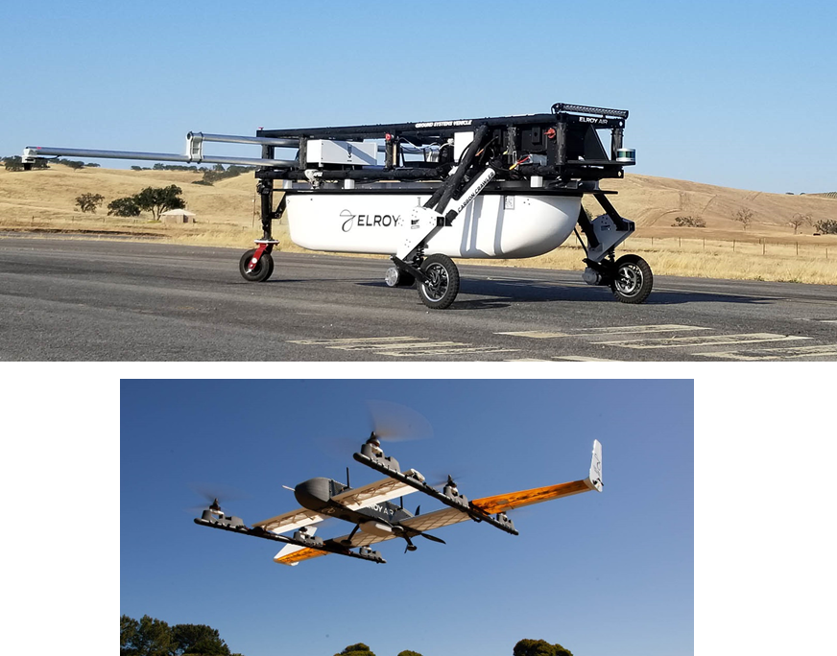
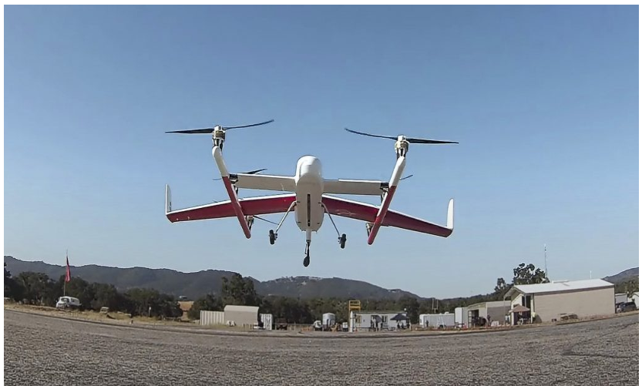
Success Stories: Chapparal
Start-Up company regularly attended JIFX since 2018.
Autonomous Cargo UAS, 150+ lbs payload, 300-mile delivery range.
Partnerships with:
  NPS
  NASA
  USAF Agility Prime
  AYR Logistics global HA/DR operations
Notes:
USMC students at NPS currently conducting thesis research on various aspects of Chapparal for autonomous logistics in both contested and non-contested environments.

Slide 17
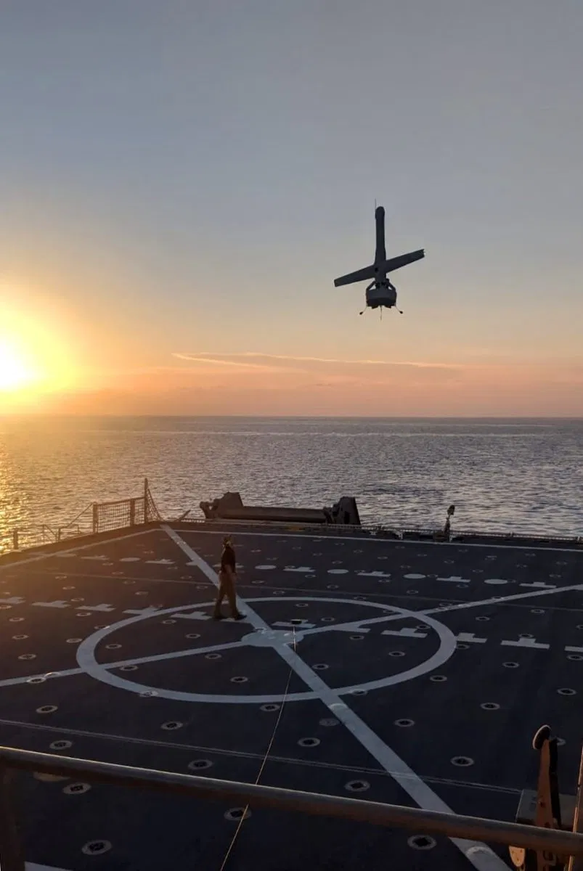
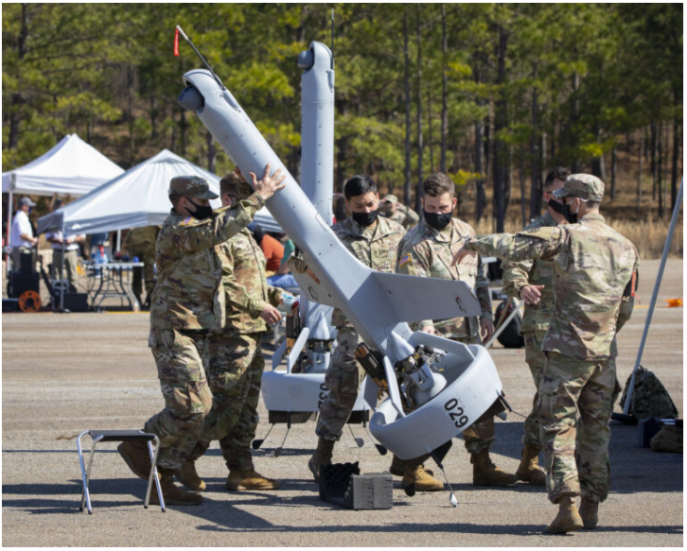
Success Stories: V-BAT
Martin UAV proved and refined V-Bat beginning in 2019
Marine Warfighting Laboratory’s Organic Reconnaissance, Surveillance, and Target Acquisition Office developed TTPs for Maritime UAV operations
Deployed and provided direct support to operations in Fall 2020 as part of the USMC’s 31st MEU.
Under contract for evaluation by Canadian Forces.

Slide 18
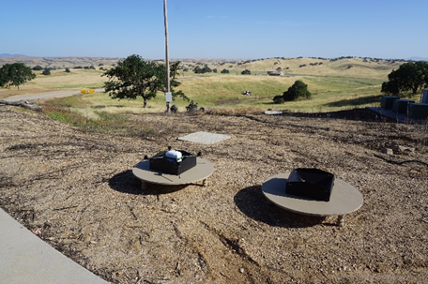
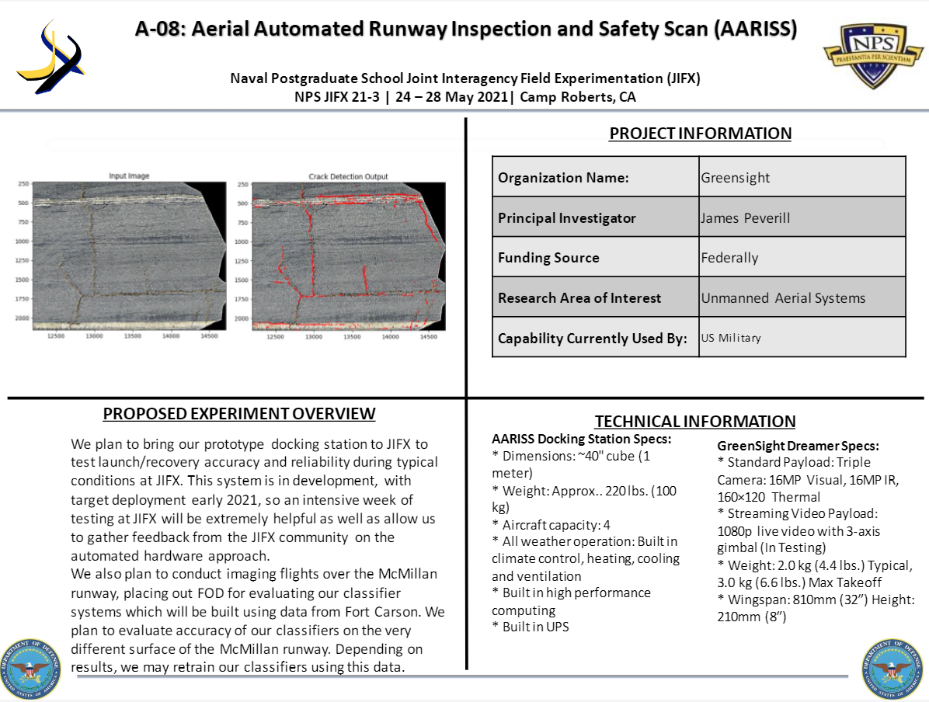
Accelerating Development: AARISS
Greensight, Inc. took stakeholder feedback at JIFX 20-2 led to develop the Aerial Automated Runway Inspection and Safety Scan (AARISS) system.
AARISS deployed to Fort Carson Army Airfield for 2020-2021.
Awarded a 2-year contract from DARPA’s Strategic Technology Office to develop the technology under the “Distributed, Secure, and Trusted Processing for Heterogeneous Swarms of Autonomous Vehicles.”

Slide 19
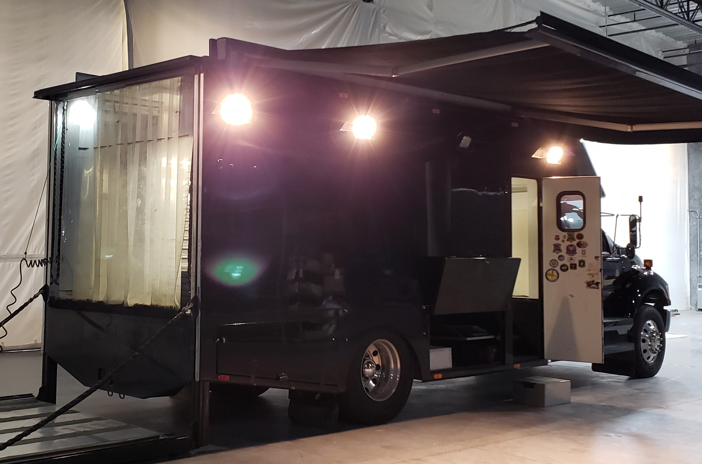
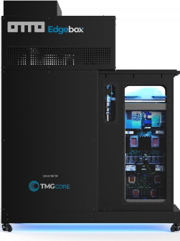
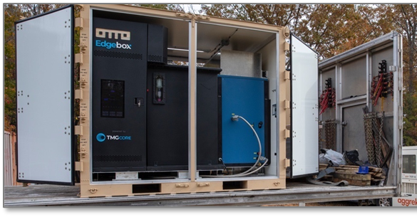
Early Engagement: Edgebox
21-3
At 21-2, TMG Core introduced 2-phase liquid cooled high-performance computing platform delivering capabilities of large-scale data center or data center PODs.
21-3 demonstrated mobile form factor of system proving potential applications for national strategic resiliency.
22-1 Distributed experiment from Thunderstorm Contested Logistics Tech Demo.
22-2 Reconfigured for maritime and aviation platforms.
Under evaluation by IQT; research partnership with NPS.
21-2
22-1

Slide 20
Value to Force
Safe, secure, legal, & collaborative venue for non-traditional technology innovators to meet with DoD
Responsive to stakeholders: 45-90 days from nomination to field observation
Cost Effective – free to attend
Fertile ground for harvesting technology and concept of employment directly to force
Notes:
1.Environment
2. Responsive
3. Cost Effective: Low overhead for technologists and commands to participate - Events are free to attend and NPS team obtains all approvals necessary for flight, frequency use, safety, etc. for each experiment
4. Potential Clearing house for tech that commands are interested in validating or advancing: Participation is open to both US and Non-US Citizens [except citizens of China and Russia or others flagged by DoN, DoD, DoS]
Allows stakeholders to engage with developers in a non-acquisition environment
5. Primary Sponsor is the USD(R&E) Rapid Reaction Technology Office
6. Helps to avoid technological surprise
7. Provides vulnerability assessments and end-user evaluations technology developers early in the development cycle

Slide 21
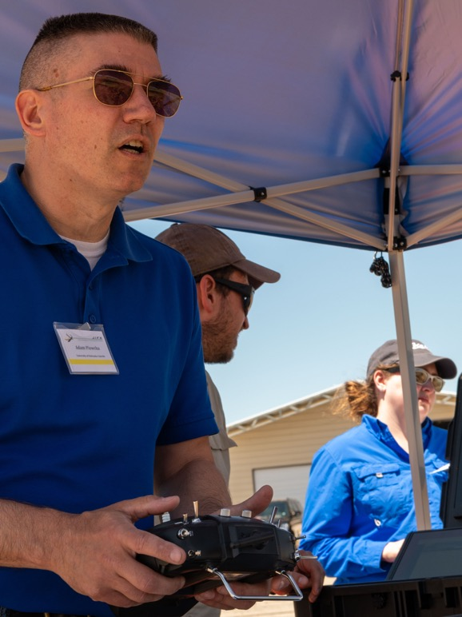
How You Can Participate
Join our Stakeholder roster
Attend an Event
  https://www.nps.edu/web/fx/home
Propose or Nominate an Experiment
  https://nps.edu/web/fx/experiment-proposal
Sponsor an Experiment Challenge
Visit “How to Participate” page: https://www.nps.edu/web/fx/participate
Notes:
Event Roles:
+ Experimenter
+ Command or Agency Stakeholder
+ Technology Evaluator
+ Observer
+ Integrating Experiment Scenario Developer
+ UxS Operator
+ Air or Spectrum Boss
+ Sponsoring Organization

Slide 22
Contact Information
Principal Investigator
Michael Richardson
mrichard@nps.edu
Events Manager
Ashley Hobson
ashobson@nps.edu
JIFX Team
Aurelio Monarrez, Flight Operations: amonarre@nps.edu
Joseph Lukefahr, Network Operations: joseph.lukefahr@nps.edu
Jonathan Coon, Data Management: jonathan.coon@nps.edu
NPS Field Laboratory at McMillian Airfield
Dirk Hale, Site Manager, dirk.hale.ctr@nps.edu
www.nps.edu/fx

