Slide 1
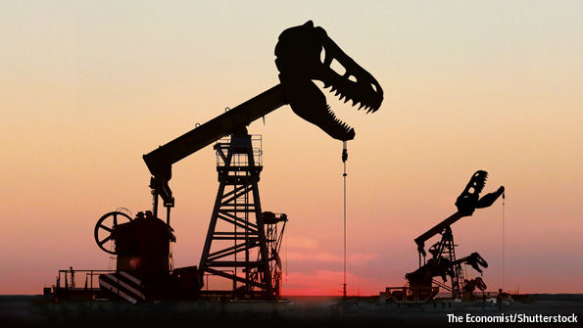
The Geopolitics of Cheap Oil
6 January 2017
Emily Meierding, Ph.D.
Naval Postgraduate School
Notes:
The Geopolitics of Cheap Oil
"In the late 2000s, oil prices seemed poised for a permanent increase. Commentators lamented the end of “cheap oil” and predicted intensifying competition over the world’s dwindling petroleum supplies. However, when oil prices crashed at the end of 2014, the international energy landscape changed dramatically. Suddenly, oil-exporting and importing countries were faced with an oil glut. This talk explains why the price crash occurred and explores its geopolitical implications. In particular, it examines how oil-exporting countries are responding to their growing financial crises and how these responses could impact energy and political security in the United States."

Slide 2
Current Oil Price
WTI: $54.01 per barrel
Source: Bloomberg, 10:11 a.m., 6 January 2017

Slide 3
Roadmap
How Did We Get Here?
Effects of Cheap Oil
Economic Effects: Small Winners, Big Losers
How Oil Producers are Coping
Political Effects for Oil Producers
Broader Geopolitical Effects
Notes:
Overall takeaway: the economic effects of cheap oil are likely to be more pronounced than the geopolitical effects

Slide 4
Argument
The geopolitical impacts of cheap oil are likely to be surprisingly limited.
Notes:
Overall takeaway: the economic effects of cheap oil are likely to be more pronounced than the geopolitical effects

Slide 5
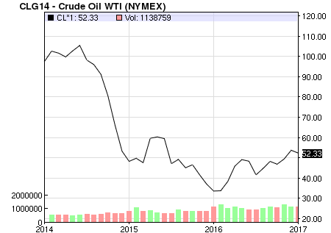
Prices Since the 2014 Crash
Source: NASDAQ, 3 January 2017

Slide 6
How Did We Get Here?
1. Growing oil supplies:
Unconventional oil production booms
Shale/tight oil (esp. U.S.)
Oil sands (esp. Canada)
“Frontier” resources (e.g. Arctic)
Iraqi oil production revives

Slide 7
Global Oil Production
+3.6 mbpd
+1.3 mbpd
+1.6 mbpd
Notes:
Replace/update

Slide 8
U.S. Tight Oil Production
Source: EIA, collected by DrillingInfo, Inc.
2002
2004
2006
2008
2010
2012
2014
Notes:
Millions of boe/day

Slide 9
How Did We Get Here?
1. Growing oil supplies:
Unconventional oil production booms
Shale oil/tight oil (esp. U.S.)
Oil sands (esp. Canada)
“Frontier” resources (e.g. Arctic)
Iraqi oil production revives
2. Weakening oil demand:
…in developed countries (since approx. 2005)
…in developing countries (since approx. 2014)

Slide 10
The Price Crash
Summer 2014: Libyan exports rebound; IS advance halts
November 2014:
OPEC meets, does not cut production
July 2015:
Iran nuclear deal
November 2016:
OPEC and non-OPEC countries agree to cut production

Slide 11
A Price Revival?
Prices have rebounded from their low point ($30-$35/barrel) in early 2016.
But, prices are expected to stay low (< $60/barrel)
Reasons:
Tepid global demand
Cooperation among oil producers is uncertain
U.S. tight oil producers’ response

Slide 12
U.S. Rig Count (2013-2016)
Notes:
Swap out? What was I doing with this slide?

Slide 13
How Did We Get Here: The Takeway
$100 per barrel oil won’t be coming back any time soon*
* Do not place bets on this. The only certainty about the oil market is that there are no certainties about the oil market.

Slide 14
Economic Effects of Cheap Oil
Small Winners | Big Losers
Oil consumers Europe Japan Developing countries (incl. China and India) | Oil producers OPEC members Russia
United States

Slide 15
Small Winners: Consumers
Benefits of cheap oil for consumers:
No more “peak oil” fears
Lower prices for oil and other commodities
Could encourage spending, economic growth
Improves trade balances

Slide 16
Small Winners: Consumers
Benefits of cheap oil for consumers:
No more “peak oil” fears
Lower prices for oil and other commodities
Could encourage spending, economic growth
Improves trade balances
But...
Developing countries are often commodity exporters
Europe and Japan may face deflation
Benefits have been lower than expected

Slide 17
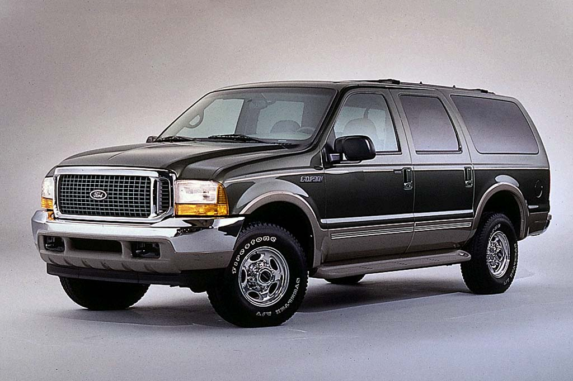
Stuck in the Middle: The U.S.
Gains:
Same as for other consumers: lower oil/gas prices, better trade balance, no peak oil fears
Lifted crude oil export ban (2015)
Gasoline consumption up
More SUVs

Slide 18
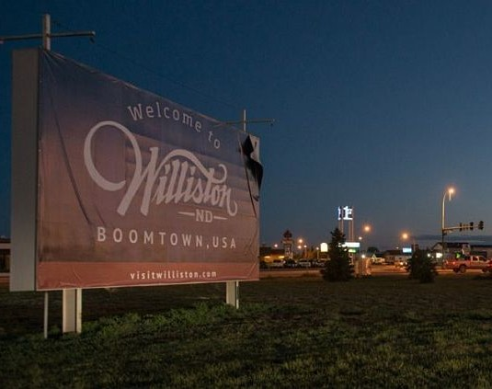
Stuck in the Middle: The U.S.
Losses:
Jobs in oil industry and beyond
Lower revenue for oil producing states
Lower investment
On balance, U.S. is better off with cheap oil: more winners than losers

Slide 19
Big Losers: Producers
Losses for oil producers:
Lower oil price = less revenue for the government
Threatens “pact” between governments and people
Government can’t maintain previous spending levels
Popular support declines
Notes:
Make sure I include the chart of break even prices.
After this: explain why each of these 2 things could happen.
Then, consider 1980s as a precedent. Did these 2 things happen?
Then, look at countries today.
What about for the US, from a geopolitical perspective?

Slide 20
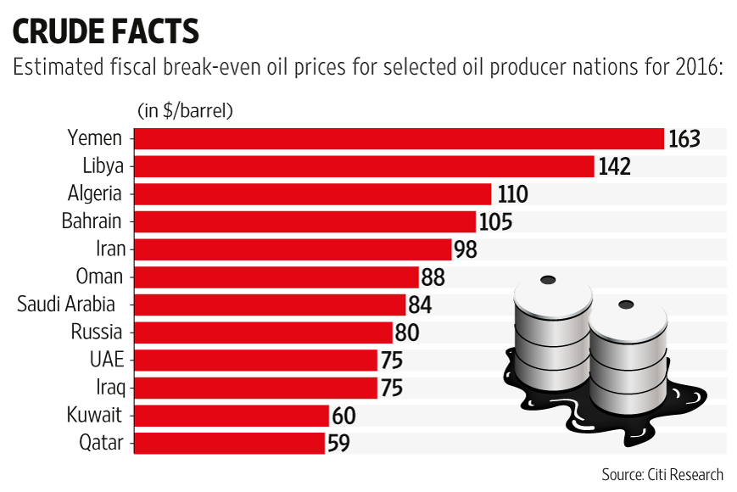
Big Losers: Producers
Notes:
Make sure I include the chart of break even prices.
After this: explain why each of these 2 things could happen.
Then, consider 1980s as a precedent. Did these 2 things happen?
Then, look at countries today.
What about for the US, from a geopolitical perspective?

Slide 21
Big Losers: Producers
Notes:
Make sure I include the chart of break even prices.
After this: explain why each of these 2 things could happen.
Then, consider 1980s as a precedent. Did these 2 things happen?
Then, look at countries today.
What about for the US, from a geopolitical perspective?

Slide 22
Compensating for Shortfalls
Draw on financial reserves (e.g. Saudi Arabia)
$740 billion
$570 billion
Notes:
Built up reserves during high prices.
In < 2 years, went through $170 billion.
Has probably declined by another $30+ billion by now.
Although not down to zero; y axis on left is misleading.

Slide 23
Compensating for Shortfalls
Find alternative revenue sources
Borrow money (loans, bond sales)
Sell state assets (incl. privatization)
Collect more taxes
Increase government fees
Diversify economy
Notes:
2a) Jan 2016: Nigeria sought $2.5 billion from World Bank, $1 billion for ADB
By Feb 2016, AZE had sought loans
April 2016: SAR seeks $10 billion loan
SAR has also sold bonds, domestically and internationally.
April? 2016: Abu Dhabi does $5 billion bond sale
May 2016: Qatar announces $9 billion bond sale
Jul 2016: KUW announces almost $10 billion bond sale
2b) Countries can privatize state-owned industries
SAR is considering selling a 5-10% stake in it’s NOC, Saudi Aramco
Oct 2016: NIG selling 2 presidential jets
2c) Dec 2015: AK considering income tax
Feb 2016: 6 GCC states agreed to implement a VAT [sales tax], starting in 2018
Feb 2016: Dubai introduces hotel occupancy tax
April 2016: SAR considering taxes on energy drinks, sugary drinks, luxury items. Also more taxes on expats.
July 2016: Dubai introduces departure tax on intl flights
2d) Feb 2016: Dubai increases fees for visa extensions, business licenses, etc.
2e) Classic example = Dubai: banking
Current example = SAR: minerals, petrochem, tourism

Slide 24
Compensating for Shortfalls
Tighten their belts
Reduce subsidies
Gasoline
Electricity
Water
Cut government spending
Slow government hiring
Reduce government paychecks
Cut back social services
Notes:
3ai) Feb 2016: VEN increased fuel prices by 1300%, up to 38 cents/gallon
Aug 2016: KUW announces up to 80% increase in gasoline prices. Was the LAST Gulf country to cut subsidies; Bahrain, Oman, Qatar, Saudi Arabia and the United Arab Emirates already had
Jan 2017: this month, MEX plans to increase fuel prices by up to 20%
3aii) April 2016: KUW increases prices of electricity and water for businesses and expats
Oct 2016: Oman will increase charges for some big consumers for electricity. SAR and UAE have also increase utility rates
3bi) Has been happening in SAR
3bii) Has been happening in SAR. As part of Vision 2030, want to clamp down public sector salaries.
[although, SAR also doled out big bonuses in late June…]

Slide 25
Compensating for Shortfalls
These strategies can help some, for a while
But, they can also provoke a backlash
People don’t like:
Paying higher prices for gasoline and utilities
Higher taxes
More fees
Fewer government jobs
Lower government salaries
Economic dislocation

Slide 26
Possible Political Effects for Producers
1. Domestic Instability
Less Oil Revenue
Lower Popular Support
2. Foreign Aggression

Slide 27
Possible Political Effects for Producers
1. Domestic Instability
Less Oil Revenue
Lower Popular Support
2. Foreign Aggression

Slide 28
Domestic Instability
E.g. Venezuela
Source: The Guardian, 11 October 2016
Notes:
Was already facing tough economic conditions before price collapse.
Chavez (until 2013) and successor Maduro overspent.
Also, didn’t let PdVSA reinvest, so production dropped. Has fallen by 450,000 barrels a day from its 2014 level of 2.7m barrels.
Plus, state was victim of classic Dutch disease. Domestic production of other goods dropped dramatically.
Plus, with state subsidizing things like rice, sugar, toilet paper, sanitary towels and medicine—and also cars, homes, DVD players.. (and setting low prices for producers), there was no incentive to grow/produce them.
When oil price dropped, state could no longer afford sufficient imports.
People face shortages of the most basic goods, incl. food and medicine.
Massive inflation: over 500% last year alone
Looting, food riots, rallies against the govt (Oct)
Government has sustained itself with loans from China, denominated in oil.
And, by becoming increasingly authoritarian, preventing popular referendum last fall.
But, the situation is disastrous and it seems like just a matter of time. But, it has seemed that way for the last year, and Maduro is still hanging on.
Still, this is a case where the drop in oil revenue is causing (or, rather, exacerbating) serious domestic instability.

Slide 29
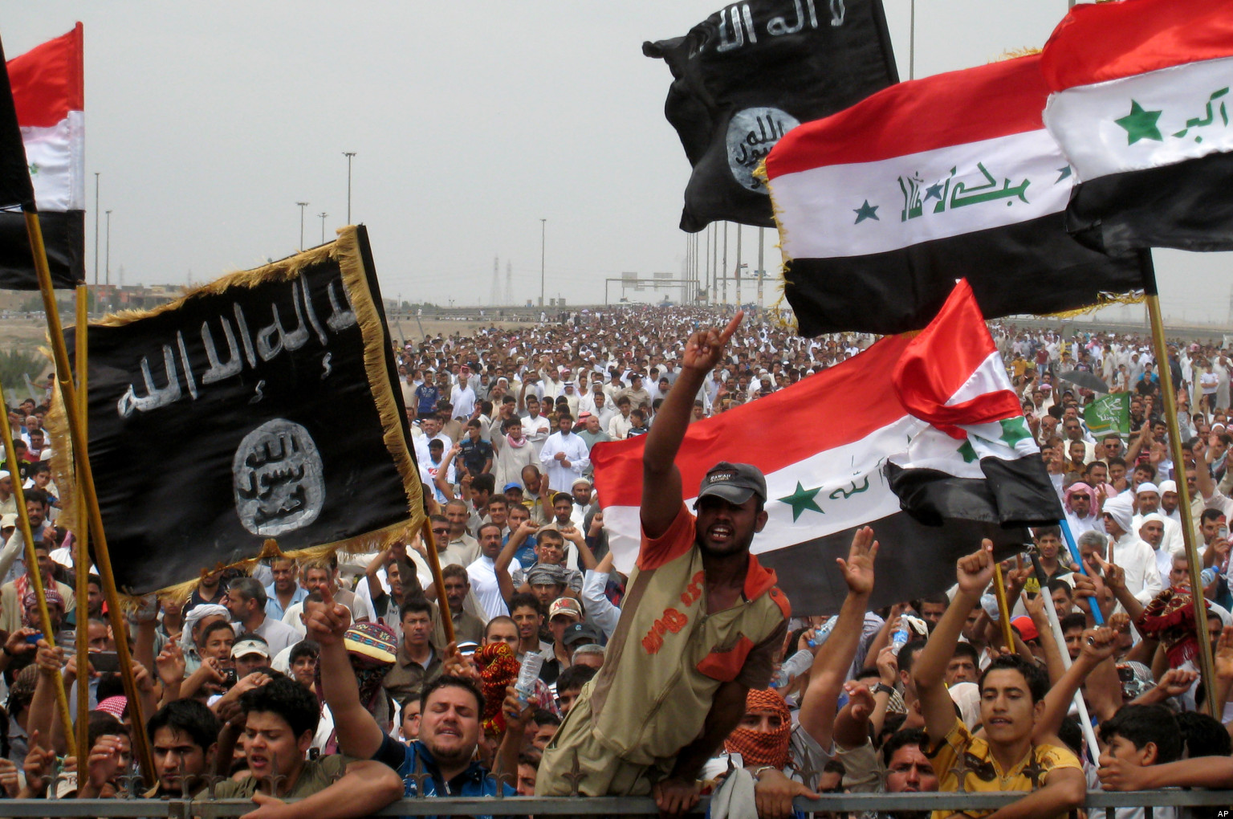
Domestic Instability
E.g. Iraq
Notes:
Still need to replace photo, figure out what my story is/what’s happening now.

Slide 30
Domestic Instability
Worst case scenarios:
Regimes topple
Countries fracture

Slide 31
Can Today’s Producers Survive?
Most probably can:
Saudi Arabia can rely on reserves
Iran has proved its resilience since 2012
Iraq will receive foreign assistance
Russia seems to be sustaining itself
Venezuela probably can’t:
But, instability will consist of debt default, change in government, not civil war

Slide 32
Domestic Instability
Geopolitical impacts:
Limited, because most regimes will survive
Could make Middle East more peaceful, if producers save money by ending foreign interventions
Syria
Yemen

Slide 33
Possible Political Effects for Producers
1. Domestic Instability
Less Oil Revenue
Lower Popular Support
2. Foreign Aggression

Slide 34
Foreign Aggression
= militarized attacks against other countries
Why producers might attack:
To increase oil prices and national revenue
To generate a rally ‘round the flag effect

Slide 35
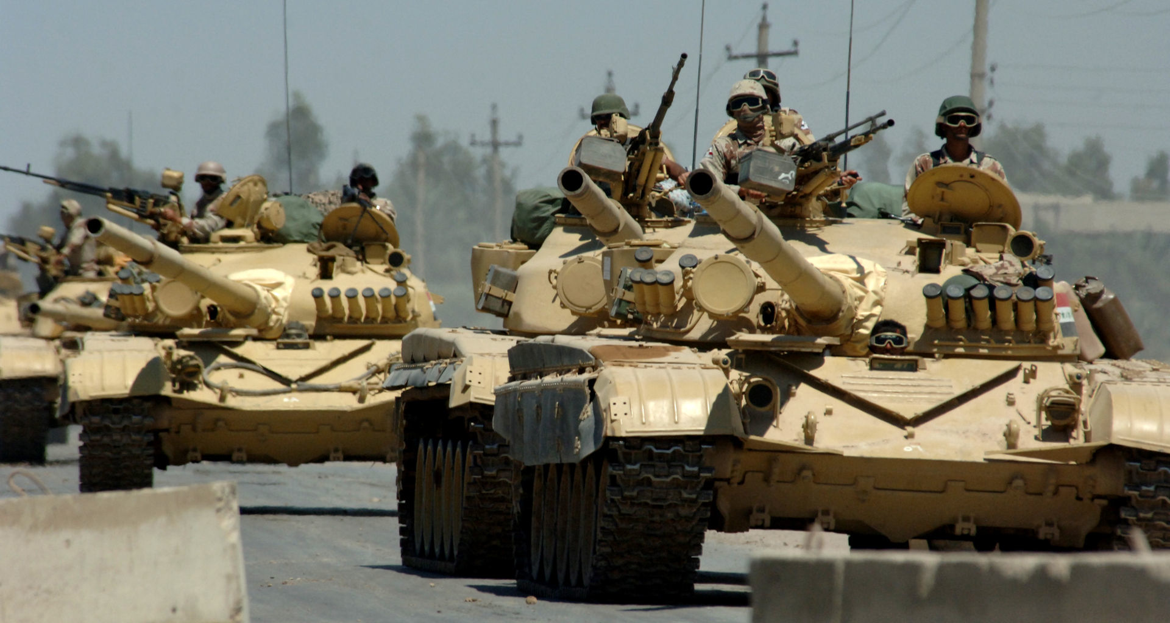
Foreign Aggression
Incentive #1: Price manipulation
Aggression may cause a price increase by:
Destabilizing a targeted oil producer
Giving an aggressor control over large share of oil supplies
E.g. Iraq’s invasion of Kuwait (1990)?

Slide 36
Foreign Aggression
Likelihood = Low
Historical example (Iraq 1990) is a bad fit
Seizing another producer is costly
Payoffs are uncertain
Destabilization causes other problems
Other oil producers will benefit more

Slide 37
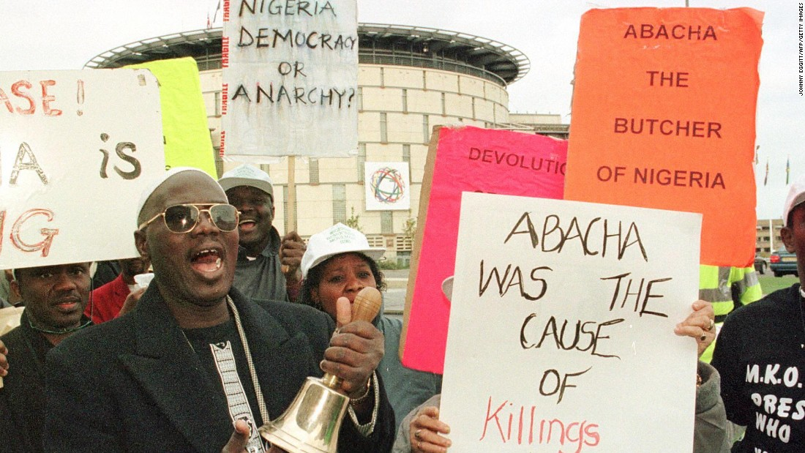
Foreign Aggression
Incentive #2: Rally ‘Round the Flag
By attacking another country, a government may increase its popular support
E.g. Nigeria’s invasion of Cameroon (1990s)?

Slide 38
Foreign Aggression
Likelihood = Moderate
Has already occurred since this price collapse
Venezuela–Guyana (2015)
Small actions can generate big bumps in support
However...
Outcomes are uncertain
Doesn’t work for all governments
Russia may be tempted, esp. if cheap oil persists

Slide 39
Will Today’s Producers Attack?
Probably not:
They won’t attack to raise oil prices
Russia might attack to produce a ‘rally round the flag effect

Slide 40
Foreign Aggression
Geopolitical impacts
Limited, because most producers won’t attack

Slide 41
Effects of Cheap Oil: A Summary
Economic effects of cheap oil are large, esp. for producers
Political effects for producers are limited
Widespread domestic instability is unlikely
Foreign aggression will be rare
Consequently, broader geopolitical effects are small

Slide 42
Other Geopolitical Effects?
1. Power balance amongst oil producers:
No shift, because all are suffering
2. Power balance amongst oil consumers:
No shift, because impacts cancel each other out
3. Producer–consumer power balance:
Power has shifted from producers to consumers
Wealth is changing hands
Fears of OPEC continue to decline

Slide 43
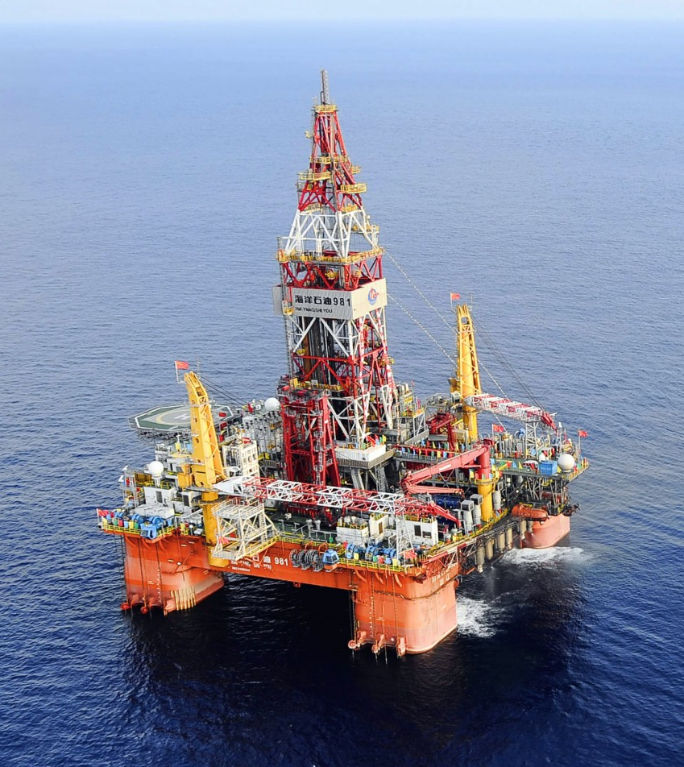
Other Geopolitical Effects?
4. International oil disputes:
E.g. South China Sea, Arctic, eastern Mediterranean
Oil at stake is less valuable
So, less dispute activity
But same levels of violence
Impact depends on oil’s roles

Slide 44
Effects for U.S.
Overall, U.S. is a winner
Economic benefits > losses
Shale oil companies can rebound quickly
Greater energy security
May need to provide more financial support to floundering oil producing states
No lessening of tensions in South China Sea

Slide 45
Conclusion: Less Than Meets the Eye
Geopolitical impacts of cheap oil are limited, especially at current price
The current situation is likely to be stable
Supply and demand will rebalance
US shale oil production will sustain ceiling on prices
Producers will adjust to $60/barrel oil

Slide 46
The End?
Source: Daily Express, 7 March 2016

