Slide 1



Slide 2
An introduction to the
Naval
Postgraduate
School
V1 – March 2012

Slide 3

The Naval Postgraduate School is a mission-driven institution.
“NPS provides high-quality, relevant and unique advanced education and research programs that increase the combat effectiveness of the Naval Services, other Armed Forces of the U. S. and our partners, to enhance our national security.”

Slide 4

NPS is a graduate-level research university, applying academic rigor to a defined niche.
Responds to joint, interagency, emerging needs and coalition requirements of the Departments of Navy, Defense, Homeland Security and more
Defends the nation, leading and transforming the DOD
Fosters a multi-service, interagency, coalition learning environment
Prepares the joint intellectual leaders for tomorrow's joint forces

Slide 5

NPS has a long, rich history in the pursuit of innovative education to improve national security.
1909 - Founded at the U.S. Naval Academy
1951 - Moved to Monterey
1951 - Operations Research department
1956 - Systems Management department
1972 - National Security Affairs department and
War-Fighting curricula (anti-submarine warfare)
1996 - Information Warfare curriculum
1999 - Joint Professional Military Education campus
2003 - Homeland Security curriculum
2004 - Information Operations
2011 - Cyber Systems and Operations

Slide 6

NPS fulfills the graduate education needs of the
Department of Defense.
Master’s Degrees, Ph.D., Engineer, MBA, EMBA, more
Accelerated, defense-focused degree programs unique in academia
Interdisciplinary, relevant, agile – from expressed need to delivered program with an extremely quick turnaround.
Biennial program reviews by flag-level sponsors

Slide 7

NPS was recently awarded a
10-year reaccreditation, the longest term achievable.
WASC Western Association of Schools
and Colleges
ABET Accreditation Board for Engineering
and Technology
AACSB Association to Advance Collegiate
Schools of Business
NASPAA National Association of Schools of
Public Affairs and Administration

Slide 8
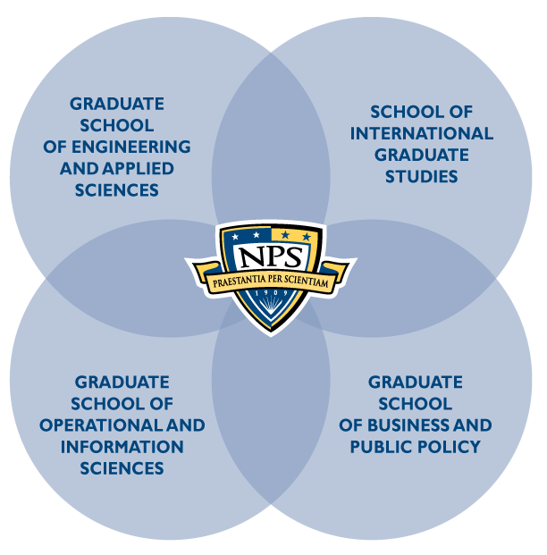
NPS is relevance delivered.
Four focused graduate schools
Interdisciplinary research centers combine expertise from across campus
Unique, relevant curricula

Slide 9

The Graduate School of Engineering and Applied Sciences develops leading-edge technological advancements with strict applications to DOD’s needs.
Applied Mathematics
Combat Systems Science and Technology
Electronic Systems Engineering (resident and DL)
Mechanical and Aerospace Engineering
Mechanical Engineering for Nuclear Trained Officers (DL)
Meteorology and Oceanography
Meteorology
Oceanography
Operational Oceanography
Reactors/Mechanical Engineering
Space Systems Engineering
Space Systems Operations
(with GSOIS) (resident and DL)
Systems Engineering
(resident & DL)
Systems Engineering Management (DL)
Undersea Warfare
(domestic and international)
Underwater Acoustic
Systems (DL)

Slide 10

The Graduate School of Operational and Information Sciences is the Navy’s path to Information Dominance.
Computer Science (Res & DL)
Computer Technology (DL)
Cost Estimating & Analysis (DL)
Electronic Warfare Systems
Human Systems Integration
Identity Management and Cyber Security (Resident & DL)
Information Sciences
Information Systems & Operations
Information Systems & Technology
Information Warfare
Joint C4I Systems
Joint Information Operations
Joint Operational Logistics
Modeling, Virtual Environments,
and Simulation
Operations Analysis
Remote Sensing
Software Engineering
(Resident & DL)
Special Operations
Systems Analysis (DL)

Slide 11

The Graduate School of Business and Public Policy provides unique education and research in the business of defense management.
Resident Programs
MBA Degrees
Acquisition & Contract Management
Defense Business Management
Financial Management
Information Systems Management
Material Logistics Support
MSM Degrees
Defense Systems Analysis
Manpower Systems Analysis
Non-Resident Programs
Contract Management (DL)
Program Management (DL)
Executive MBA (DL)
Professional Development Programs
Advanced Acquisition Program
Cost Management Certificate
Practical Comptrollership
Human Resources
Conrad Scholar Program

Slide 12

The School of International
Graduate Studies provides an education for today’s global society.
Security Studies
  Civil-Military Relations
  Stabilization and Reconstruction
  Defense Decision Making
  and Planning
  Combating Terrorism: Policy and Strategy
  Homeland Defense
  and Security (Military and Civilian)
  Security Studies
Regional Studies
  Middle East,
  South Asia and
  Sub-Saharan Africa
  Europe and Eurasia
  Far East, Pacific, Southeast Asia
  Western Hemisphere

Slide 13

NPS delivers relevant educational programs to students who don’t ever step a foot on campus.
Distance Learning efforts world-wide
Short-course and certificate courses through mobile education teams
Faculty and student internships in the fleet
Provides educational opportunities for:
  Potential participants
  Current enrollees
  Former students

Slide 14
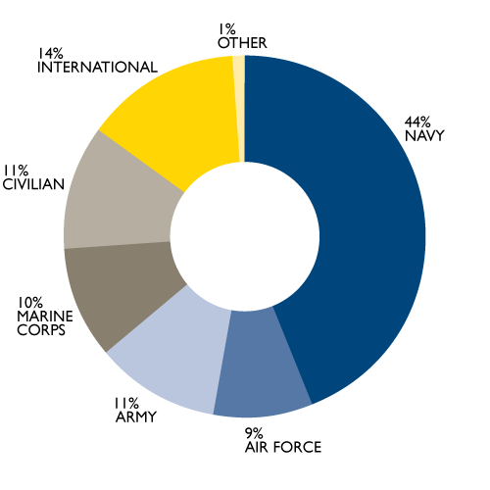
Resident Degree Students
Average on Board
AY 2011
Total Resident: 1,647
75% U.S. uniformed services
14% International
11% Government Civilian

Slide 15
International Resident Students
by Region

Slide 16

We bring the best and brightest minds to teach the next generation of leaders.
Active recruiting from top Ph.D. programs
A robust mix of tenured faculty, lecturers, visiting professors and others
Includes 8% military personnel with strong academic credentials and recent operational expertise
Integrates teaching with research
No teaching assistants
Develops technologies eligible for patents

Slide 17

A research university is only as impactful as the mentors who guide its students.
737 Faculty Members
  269 with tenure or
  tenure-track
Recent Patents
  Vest Antenna
  High-intensity light and sound control device
  Turbulence-resolving acoustic sediment flux probe
  Mixed-mode fuel transit optimization
Sources of Faculty Graduate Degrees
  UC Berkeley 22
  Stanford 17
  MIT 12
  UCLA 10
  Univ. of Texas 7
  Univ. of Washington 7
  UC Davis 6
  Harvard 6
  UC San Diego 6
  Yale 5
  Univ. of Southern CA 5

Slide 18
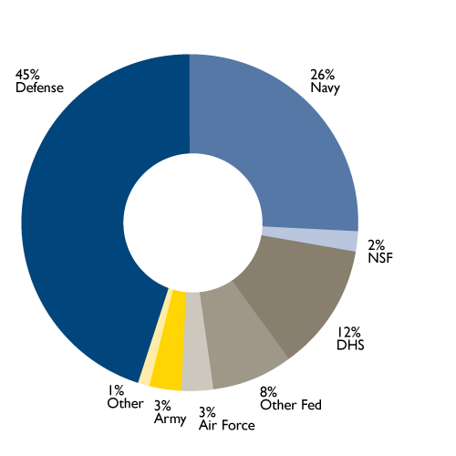
Research is an integral piece to the puzzle.
Responds to DOD/DON/DHS needs
$185.3M+ in executed programs
Rapid delivery from thought to fleet

Slide 19

At the cutting edge of cybersecurity research and education.
Two-dimensional approach through research and dedicated curricula
Developing dedicated Cyber battlelab
Interdisciplinary core instruction, from Computer Science and Math to Defense Analysis and Operations Research

Slide 20

A national Center of Excellence in adaptive optics education and research.
Three-Meter Segmented Mirror Telescope on campus
Prototype reconnaissance satellite on site (not flown)
Unique, experimental test-beds for dedicated faculty/student education and research
Research to advance capabilities in optics, vibration control, etc.

Slide 21

Advancing unmanned systems, from technical to tactical.
CRUSER – Consortium for Robotics and Unmanned Systems Education and Research
  SECNAV initiated / Chartered by Under Secretary Robert Work
  A cross-disciplinary community of experts in research and education across ALL areas of robotics and autonomous systems
  From technical to ethical, concept generation to experimentation.

Slide 22

Providing the premier forum for the advancement of defense acquisitions.
9th year leading the Acquisition Research Symposium
Multidisciplinary approach to all facets of cost, supply, performance mgmt. and more
Defining a body of scholarly knowledge in defense acquisition unparalleled in government or academia

Slide 23

Rapid deployment from field experimentation to fleet utilization.
Rapid technology integration from field to fleet and joint warfighter
Diverse applications — including autonomous, remote systems and battlefield medical
Multi-discipline, campus-wide efforts
Multi-institutional partnerships — with hundreds of industry, academic and government organizations participating

Slide 24

Playing a lead role in the evolution of securing our homeland.
Center for Homeland Defense and Security
    The nation’s first graduate degree in homeland security.
    439 graduates to date.
    Students come from DHS, police, fire, EMS, military and several others at local, state, federal and tribal levels.
    Mixed residence and web delivery, mobile education, executive leaders program, UAPI.
  Executive education seminars for 16 governors
  in 13 states and territories.
California
Colorado
Delaware
Florida
Georgia
Guam
Hawaii
Michigan
Nebraska
New Mexico
Tennessee
Wyoming
Commonwealth of Northern Mariana Islands

Slide 25

With over 50,000 graduates,
NPS alumni range from admirals to astronauts, service chiefs to chief executives.
Representing all U.S. military services, government agencies, defense industry leaders, and many more
5,193 officers from 103 countries
16% of U.S. Navy active-duty Flag Officers
About 28,300 resident and non-resident non-degree participants annually
Alumni include:
  Adm. Mike Mullen, Former Chairman, Joint Chiefs of Staff
  Gen. Michael Hagee, Former Commandant, USMC
  King Abdullah of Jordan
  Adm. William McRaven, Commander, U.S. Special Operations Command

Slide 26

NPS is a leading member of Team Monterey, a collaborative effort combining the strengths of DOD institutions across the county.
Created by Congressman Sam Farr to synchronize county DOD institutions for maximum benefit
Unique missions, unique strengths
DOD/DHS applications
Efficient use of federal funding
Additional members include:
  Defense Language Institute Foreign Language Center
  Fleet Numerical Meteorology and Oceanography Center
  Camp Roberts
  Department of Defense Manpower Data Center
  Naval Support Activity Monterey
  Naval Research Laboratory

Slide 27

NPS is a world-class, research university — a valued, strategic investment for the future of our nation.
Education is the ultimate provider of transformative thought leaders
Agile, unique programs focused on joint military applications like no other institution in the world
Relevant research responds to the immediate and future needs of the national security enterprise
Executive, distance and continuing education deliver programs regardless of when and where
Building international capacity, developing coalitions with partners across the globe

Slide 28
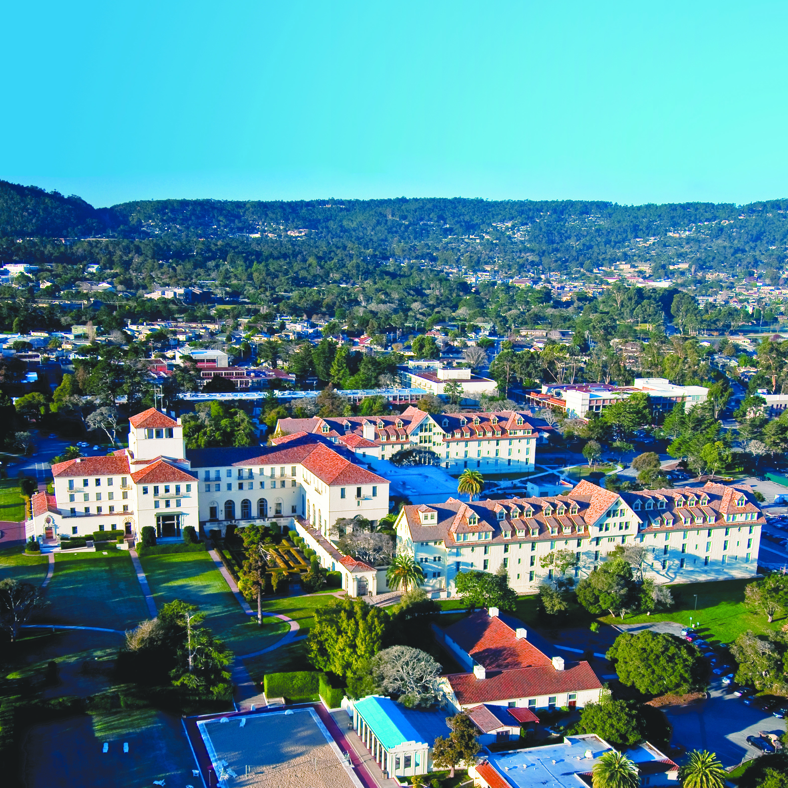
NAVAL POSTGRADUATE SCHOOL
1 University Circle • Monterey, Calif. 93943
(831) 656-1068 • pao@nps.edu • www.nps.edu

