Slide 1
Command Brief
Summer (4th) Quarter
Academic Year 2012
Excellence Through Knowledge

Slide 2

Notes:
2
Left Screen : GWHBush “Welcome to NPS” (1:02)
Right Screen : Campus footage (1:00)
Note: Video clips come on automatically. Upon finishing, click the mouse or use the arrow keys to advance forward to the next slide.

Slide 3
Mission of the Naval Postgraduate School
NPS provides high-quality, relevant and unique advanced education and research programs that increase the combat effectiveness of the Naval Services, other Armed Forces of the U.S. and our partners, to enhance our national security.
Notes:
3
The key words in our mission statement are combat effectiveness. All of our degree programs contain military applications, both in the class room and the research laboratory. This military content is what makes us unique and different from traditional colleges and universities

Slide 4
The Naval Postgraduate School is a . . .
History Highlights
  Graduate University
  Responsive to joint, interagency, and coalition requirements
  Research Institution
  Pursuing innovative technology
  and improving national security
  Community of Alumni
  Leading and defending the Nation and transforming the Department of Defense (DoD)
1909 | Founded at the U.S. Naval Academy
1951 1951 | Moved to Monterey Operations Research Department
1956 | Systems Management Department
1972 | National Security Affairs Department
1996 | Information Warfare Curriculum
1999 | Joint Professional Military Education (JPME) campus
2003 | Homeland Security Curriculum
2004 | Information Operations
2009 | NPS CENTENNIAL
Notes:
4
Second click opens up “History Highlights”
Today we use a systems approach to education
Our core competency is resident graduate education, complemented by a robust faculty research capability. All faculty conduct reimbursable research, and all students complete a Master's level thesis
NPS provides graduate degrees with a defense focus and conducts relevant research keyed to real defense and security issues
Alumni in key leadership roles in U.S. and around the world

Slide 5

NPS . . .
  Responds
  to emerging DoD needs
  Fosters
  a multi-service, interagency, and coalition learning environment
  Prepares
  the joint intellectual leaders
  for tomorrow’s forces
CAPT Jeff Kline, USN (Ret)
Senior Lecturer
Operations Research Department
Notes:
5
Click on CAPT Kline to view his clip – 0:30sec
Agile, unique, relevant. New curricula developed quickly. Examples:
Homeland Security
Leadership and Education Management Development
Systems Engineering and Analysis
Most students are 03’s and 04’s who will go on to serve in a variety of
different assignments of increasing responsibility throughout their careers
Our goal is to develop the analytical skills of these officers (ability to
think and project)
We are teaching the next generation of leaders to think critically and
creatively and to be prepared for the uncertainties of tomorrow

Slide 6
NPS is Graduate Education…
  Masters’, Post-Masters’, and Ph.D. Degrees
  Accelerated, defense-focused degree programs
  Interdisciplinary, relevant, agile
  Biennial program reviews by flag-level sponsors
Notes:
6
NPS operates at the master’s degree level. Must have an undergraduate degree to enter. Several things make our method of education unique and different from civilian universities
Transition many officers from non-technical undergrad degrees to a technical master’s through series of refresher programs (calculus, calculus-based physics, statistics, modeling and simulation courses)
Operate a student-demand driven schedule; four 12 week quarters (students in class 48 weeks a year) which reduces dead time and meets operational requirements
All curricula have a military sponsor that utilizes graduates in sub-specialty billets; two year revolving curriculum review process that establishes and validates the educational skill requirements (ESR’s). The ESR’s are the military applications that are not found in civilian programs

Slide 7




NPS is Accredited by . . .
WASC Western Association of Schools and Colleges
ABET Accreditation Board for Engineering and Technology
AACSB Association to Advance Collegiate Schools of Business
NASPAA National Association of Schools of Public Affairs and Administration
Notes:
7
Awarded maximum length of certifications
Speaks to our reputation among civilian colleges and
universities and to the quality of our programs
In addition to the general accreditation by WASC, the engineering and business school have professional accreditations.

Slide 8
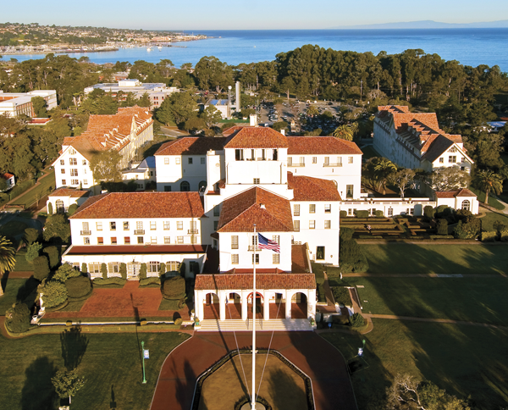
Four Schools Deliver Education
Graduate School of Engineering and
Applied Sciences:
22 Curricula
464 Resident Students
School of
International
Graduate Studies:
11 Curricula
387 Resident Students
Graduate School of Operational and
Information Sciences:
23 Curricula
596 Resident Students
Graduate School of Business and
Public Policy:
17 Curricula
282 Resident Students

Slide 9

Notes:
9
Left Screen : GWHBush “Welcome to NPS” (1:02)
Right Screen : Campus footage (1:00)
Note: Video clips come on automatically. Upon finishing, click the mouse or use the arrow keys to advance forward to the next slide.

Slide 10
Graduate School of
Engineering and Applied Sciences
22 Curricula, 464 Resident and 502 Distance Learning (DL) Degree Students (Summer (4th) Qtr AY 2012)
Applied Mathematics
Combat Systems Science
and Technology
Electronic Systems Engineering (Resident & DL)
Mechanical & Astronautical Engineering
Mechanical Engineering for Nuclear Trained Officers(DL)
Meteorology and Oceanography
Meteorology
Naval/Mechanical Engineering
Oceanography
Operational Oceanography
Reactors/Mechanical Engineering
Space Systems Engineering
Space Systems Operations
(with GSOIS) (Resident & DL)
Space Systems Operations (International) (with GSOIS)
Systems Engineering (Resident & DL)
Systems Engineering Management (DL)
Undersea Warfare
Undersea Warfare (International)
Underwater Acoustic Systems (DL)
Notes:
10
Our reputation was founded on our engineering programs. Traditional EE and ME programs, but with the military applications imbedded throughout.
Combat Systems curriculum results in an applied physics degree but students take military tracks in:
underwater acoustics
weapons effects
missile design and technology
International programs do not contain classified information

Slide 11

Graduate School of
Operational and Information Sciences
23 Curricula, 596 Resident and 134 Distance Learning (DL) Degree Students (Summer (4th) Qtr AY 2012)
Computer Science (Res & DL)
Computing Technology (DL)
Cost Estimating & Analysis (DL)
Cyber Systems and Operations
Electronic Warfare Systems International
Human Systems Integration (Res & DL)
Identity Management and Cyber Security (Resident & DL)
Information Sciences
Information Systems & Operations
Information Systems & Technology
Information Warfare
Joint C4I Systems
Joint Information Operations
Joint Operational Logistics
Modeling, Virtual Environments,
and Simulation
Operations Analysis
Remote Sensing
Software Engineering (Resident & DL)
Special Operations
Systems Analysis (DL)
John Arquilla
Professor
Department of Defense Analysis
Notes:
11
GSOIS is our largest school and contains most of the war-fighting curricula that were established during the Viet Nam era. Curricula such as C4I Systems, Informational Warfare, Electronic Warfare and Special Operations are not duplicated any where else. Our Operations Research Dept is among the top 3 or 4 in the US.

Slide 12
17 Curricula, 282 Resident and 363 Distance Learning (DL) Degree Students (Summer (4th) Qtr AY 2012)
Graduate School of
Business and Public Policy
Acquisition & Contract Management
Contract Management (DL)
Program Management (DL)
Defense Systems Analysis
Defense Business Management
Defense Systems Management (International)
Manpower Systems Analysis
Information Systems Management
Executive MBA (DL)
Civilian Executive MBA (DL)
Executive Management
Financial Management
Material Logistics Support
Resource Planning and Management for International Defense
Supply Chain Management
Systems Acquisition Management
Transportation Management
Notes:
12
NPS has transitioned from a Master of Science in Systems management to a defense-focused MBA. The program contains the traditional courses of most quality MBA programs; such as accounting, macro and micro-economics, statistics, marketing, and organizational behavior. But then the students tack one of the tracks as shown on the slide in which they take a concentration of courses in a specific military management area
So that not only get the broad focus of the MBA, but the in-depth functional expertise that can then be put to use helping make our militaries run more efficiently

Slide 13
School of
International Graduate Studies
11 Curricula and 387 Degree Resident Students (Summer (4th) Qtr AY 2012)
Regional Studies
  Middle East, South Asia and Sub-Saharan Africa
  Europe and Eurasia
  Far East, Southeast Asia, Pacific
  Western Hemisphere
Security Studies
  Civil-Military Relations
  Stabilization and Reconstruction
  Defense Decision Making
  and Planning
  Combating Terrorism: Policy and Strategy
  Homeland Defense
  and Security (Military and Civilian)
Notes:
13
SIGS contains both regional and security studies. Army, USMC, Air Force, and USN foreign area officers, security assistance officers, and defense attaches take regional studies for the part of the world to which they will be assigned.
Our civil-military relations and security building curricula are one of a kind programs designed to address the problems that the emerging democracies of the world are dealing with. We have students from the Philippines, Indonesia, Malaysia, Pakistan, Kazakhstan, Jordan, Morocco, Rwanda and many of the new NATO member countries enrolled in these programs.

Slide 14

Center for Homeland Defense
and Security (CHDS)
Master's Degree Program
Sponsored by the U.S. Department of Homeland Security
Resident study and distance learning
Executive education for tomorrow’s leaders
Professor Ted Lewis
National Security Affairs
Notes:
14
Homeland Security – truly unique curricula, not duplicated elsewhere
Dept of Justice looked to NPS for their first Master’s program. Why?
Because we had the resident expertise in many areas; M&S, Info Security,
Asymmetrical Warfare, WMD
Executive education for tomorrow’s homeland security leaders
18 month master’s degree program to enhance an understanding of
Asymmetric threats
Critical infrastructure protection
Planning and budgeting strategies
Concentrates on local-state-federal cooperation

Slide 15

NPS . . .
Delivers
education where needed by
  distance learning
  mobile education teams
  faculty and student internships in the fleet
Provides
educational opportunities for
  potential participants
  current enrollees
  former students
Notes:
15
NPS offers a continuum of education designed to reach prospective and current students, as well as alumni, through a combination of mobile education, resident certificate courses and out reach to fleet concentration areas through various Distance Learning mediums.
Current EMBA programs at NAS Lemoore and NAS Pensacola. Start ups in Sept 04 in Norfolk and San Diego
Video Tele-Education engineering degree program in Wash D.C.
Leadership Education and Development master’s at the Naval Academy

Slide 16
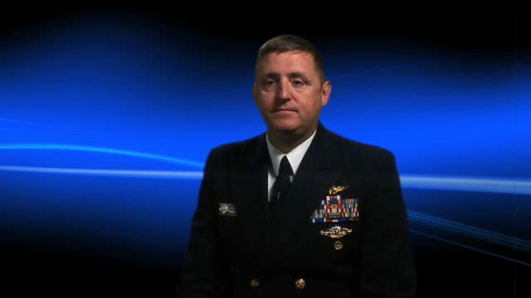
NPS is Students . . .
Resident Degree Program Enrollment (Summer (4th Qtr) AY 2012)
Total Resident: 1,760
U.S. 73% - All Military Services and Other Government Agencies
International 14% - 258 Residents from 51 countries
CDR Doug Burton
Operations Research Department
Notes:
16
Percentages speak to the joint nature of our student body
International numbers and percentage of student body are highest in school’s history. International students were first admitted back in the twenties. 4120 graduates since 1954
NPS is literally the “Crossroads” of DOD international education: more international officers from more countries than any other DOD Professional Military Education Institution
Increasing numbers of Air Force and Army students due to commitment of Service Secretaries Roache and White (both former NPS graduates)
NPS/AFIT MOU

Slide 17


International Degree Students
Summer Quarter 2012
Europe
Albania 1
Bulgaria 2 Croatia 1
Georgia 1
Germany 16
Greece 21
Hungary 1
Latvia 2
Lithuania 1
Moldova 1
Netherlands 1
Norway 7
Portugal 1
Romania 1
Serbia 2
Slovakia 1
Sweden 3
Turkey 58
Ukraine 2
123
Central/East Asia &
Middle East
Israel 1
Jordan 1
Pakistan 14
Saudi Arabia 6
Yemen 1
23
Far/Near East
India 2
Japan 1
Korea 4
Malaysia 1
Maldives 1
Nepal 1
Philippines 1
Singapore 41
Sri Lanka 3
Taiwan 15
Thailand 1
71
North America
Canada 3
Mexico 1
4
Caribbean, Central & South America
Argentina 2
Brazil 3
Chile 2
Colombia 4
11
Australia 7
Africa
Algeria 1
Cameroon 1
Egypt 1
Kenya 1
Nigeria 1
Seychelles 1
Tanzania 2
Tunisia 10
Uganda 1
19
258 Students
51 Countries
Gary Roser
Assistant Dean of SIGS
Gary Roser
Assistant Dean of SIGS
Notes:
17

Slide 18
Naval Postgraduate School Faculty . . .
  Recruits from top Ph.D. programs
  Has robust mix of tenured faculty, lecturers, visiting professors, and others
  Includes 8% military personnel,
  with strong academic credentials and recent operational expertise
  Integrates teaching with research
  Has no teaching assistants
  Develops technologies
  which are eligible for patents
Faculty Highlights
737 Faculty Members
269 with Tenure or Tenure-Track
99% with Doctorates
Sources of Graduate Degrees
UC Berkeley 22
Stanford 17
MIT 12
UCLA 10
Univ. of Texas 7
Univ. of Washington 7
UC Davis 6
Harvard 6
UC San Diego 6
Yale 5
Univ. of Southern California 5
Recent Patents
Vest Antenna
High-Intensity Light and Sound Control Device
Turbulence-Resolving Acoustic Sediment Flux Probe
Notes:
18
The intimate classroom settings and low professor to student ratio
facilitates learning experience
There are no teaching assistants at NPS
High percentage of civilian faculty and % of PhD's gives academic
credibility
Resident Patent attorney on staff. Numerous patents developed
including DOS (Gary Kildane)

Slide 19
NPS is Research . . .
Major source of analytical capability for the Navy and DoD
Creative problem solving for DoD-relevant topics
Independent assessment of proposed solutions to national-security issues
Pre-deployment evaluation of new technologies
Classified research facilities
Karl van Bibber
Vice President
and Dean of Research
Notes:
19
Primarily a teaching university, but research is vital
Key point of research is to develop analytical skills of students in the
classroom, give them a relevant project/thesis to apply to those skills
All students complete a theses or major project
Student leaves NPS with confidence that he/she can employ
education in operational world

Slide 20
NPS Reimbursable Funding
$185.3 million (FY 2011)
Notes:
20
Most research is conducted for the Navy but there are also many
other sponsors as seen here
Faculty compete for these research projects with other university and
research labs

Slide 21

Systems Engineering
Interdisciplinary projects to meet emerging technology requirements
New warship design and next generation propulsion
- Total Ship Systems
Engineering (TSSE)
Networked sensor
and weapons grids
Professor David Netzer
Distinguished Professor Emeritus
Notes:
21
Looping top video is of the Sea Lance craft. Click on it to pause/resume
Click on bottom video for Chuck Calvano discussing Sea Archer
Major initiative is coordination of yearly systems engineering
project
Annually, up to 54 students from seven departments convene to
forward research in the area of surface warfare
Primary objective: design a system of systems that meets the
projected needs of the future
The Meyer Institute’s most significant projects to date include:
Sea Lance – A bi-hull fast combatant intended to support
expeditionary warfare in the littoral environment
Sea Archer – A hybrid air-cushion-catamaran combatant
with water jet propulsion capable of speeds up to 60kts

Slide 22

High Performance Computing
Numerical weather predictions
Computing flow fields
Modeling Of Virtual
Environments, Simulations
(MOVES)
  Pixar software
Arctic Ice Shelf
Jet engine modeling
Dr. Jeff Haferman
HPC Manager

Slide 23

Space Systems
Communication
Intelligence
Navigation
Weather
Surveillance and Reconnaissance
PANSAT and NPSAT
Daniel W. Bursch
NASA Astronaut (Former)
Notes:
23
Looping video footage is of the NPS PANSAT – Petite Amateur Navy Satellite.
Click on either video to pause/resume them.
Over 50 students did their these in conjunction with the design, building,
test and evaluation, and launch of this 22” communications satellite. Satellite launched on same shuttle that carried John Glenn in Oct 1999. Still receiving data today.
Lessons learned will be used in the production of a more complex 175 lb.
Satellite (digital camera, several sensing and measuring devices) to be
launched in ‘06

Slide 24

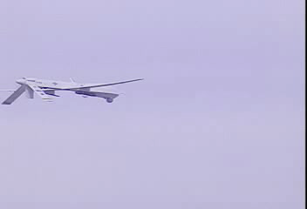
Unmanned Vehicles
Autonomous Underwater
Vehicles (AUV)
  Covert unmanned tactical recon
  Minefield mapping
  Robotic mine sweeping
Unmanned Aerial Vehicles (UAV)
  Airborne data link
  Synthetic aperture radar
  Electro-optical and
  Infrared sensor testing
Remote-Controlled Sonar (AUV)
PREDATOR (UAV)
Notes:
24
Looping top video is AUV Remote Controlled Sonar
Looping bottom video is Predator UAV
Click on either video to pause/resume them.
NPS maintains a fleet of UAV’s
NPS involved in the operational testing of Predators for years
Introduces students to cutting edge technologies applicable to important
operational requirements

Slide 25
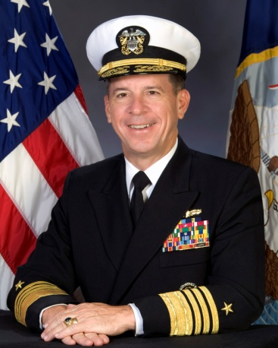


NPS is Alumni . . .
Over 50,000 Graduates
  Representing all U.S. Military Services and many government agencies
  5,338 Officers from 109 countries
  33 Astronauts
  16% of U.S. Navy active-duty
  Flag Officers
  About 27,650 Non-Degree Participants annually (includes Regional Security Education Program (RSEP))
    Resident and Nonresident
ADM Mike Mullen (Ret.)
17th Chairman,
Joint Chiefs of Staff
GEN Michael Hagee (Ret.)
33rd Commandant,
U.S. Marine Corps
King Abdullah
of Jordan
James G. Roche
20th Secretary of the Air Force
Notes:
25
Almost 500 Flag and General Officers
2 CNO’s (Burke, Watkins)
Former Secretary Army (Tom White) / Secretary Air Force(Jim Roche)
King of Jordan (Attended Defense Resources Management Institute (DRMI) 4 week Senior International Defense Management Course for flag and general officers)
Chief Defense Scientist, Singapore
At least 10 graduates have become head of their respective
services
Brazil’s first Mission Specialist Astronaut is an NPS graduate

Slide 26
Summary…
A World-Class University
Agile, unique programs focused on joint military applications
Relevant research
Executive, distance, and continuing education
Coalition building
A Strategic Investment
Notes:
26
In Summary , we view ourselves as a world class university. To be world class, a university must have world class faculty conducting world class research. Additionally, we think our students are world class as well. Older, more mature, they have made career decisions, and are focused, energetic, enthusiastic and competitive. Challenged in the class room by outstanding faculty, a synergism is achieved that results in an educational quality second to none.
The military applications, and the continuum of education provided by NPS give us a uniqueness and relevance not duplicated at civilian colleges and universities.
The coalition aspects of our international programs is also very important. Our international students are mainstreamed in our class rooms, live side by side with US students in military housing. They study and work together and establish long term relationships that are vital to meeting our national security objectives
Graduate education is a strategic investment, with both short and long term benefits. Our mobile education and short certificate programs provide mid to senior level officers with processes, procedures, techniques and principles that they can use now in their current billet assignments. For the long term, we are taking the young men and women of our armed forces and developing their analytical skills in a wide variety of disciplines. In effect, educating the future generations of our decision makers and military leaders.
G W Bush Closing remarks (0:37)

Slide 27

Team Monterey…
NPS is an active member of Team
Monterey, a collaborative effort combining the strengths of DoD institutions across the county.
Created by Congressman Sam Farr to synchronize county DoD institutions for maximum benefit
Unique missions, unique strengths
DoD/DHS applications
Efficient use of federal funding
Additional members include:
  Defense Language Institute Foreign Language Center
  Fleet Numerical Meteorology and Oceanography Center
  Camp Roberts
  Department of Defense Manpower Data Center
  Naval Support Activity Monterey
  Naval Research Laboratory

Slide 28

Notes:
28
Left Screen : GWHBush “Welcome to NPS” (1:02)
Right Screen : Campus footage (1:00)
Note: Video clips come on automatically. Upon finishing, click the mouse or use the arrow keys to advance forward to the next slide.

Slide 29
MISSION
NPS provides high-quality, relevant and unique advanced education and research programs that increase the combat effectiveness of the Naval Services, other Armed Forces of the U.S. and our partners, to enhance our national security.
7/28/10
Excellence Through Knowledge

